Slide 1




Lesson 5: Data Preprocessing
Haihua Chen, Ph.D.
Assistant Professor
9402200057
Haihua.chen@unt.edu
1/11/26

Slide 2

Agenda
1
Why Data Preprocessing
2
Data Quality
3
Data Preprocessing Tasks
4
Python Data Cleaning
5
Regular Expressions
6
Demo
1/11/26

Slide 3
1
Why Data Preprocessing
1/11/26

Slide 4
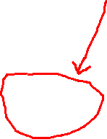
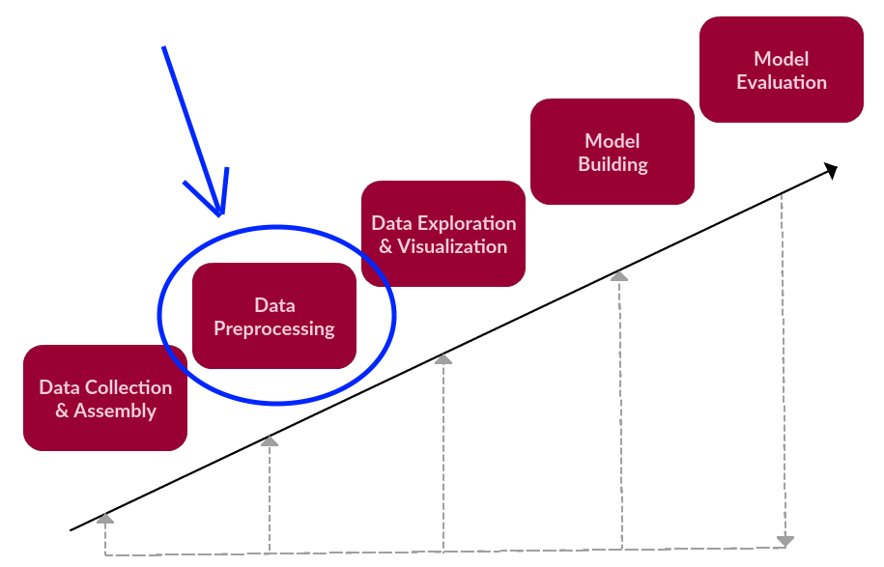
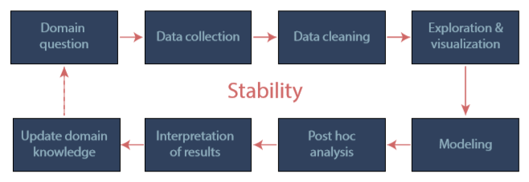


Why data preprocessing
Preprocessing in the text data analysis process
1/11/26

Slide 5
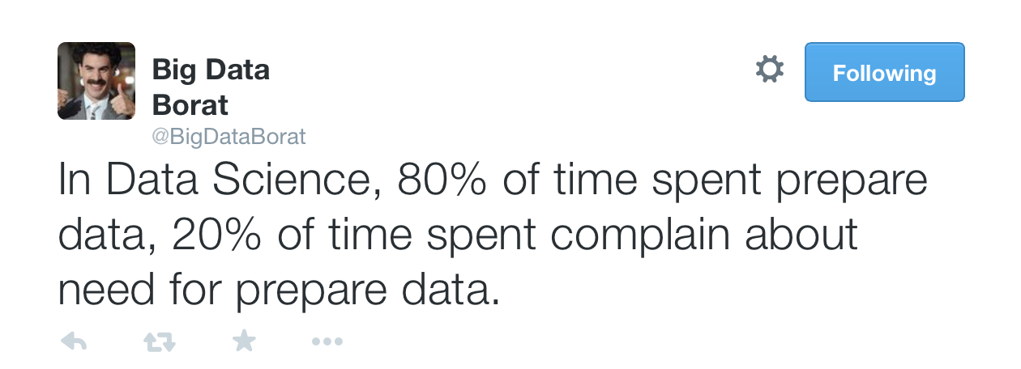
Why data preprocessing
Several key steps of text data analysis
Learning the application domain
Relevant prior knowledge and goals of application
Creating a target data set: data selection
Data cleaning and preprocessing: (may take 80% of effort!)
Data reduction and transformation
Find useful features, dimensionality/variable reduction, invariant representation
Choosing functions of data mining
Summarization, classiﬁcation, regression, association, clustering
Choosing the mining algorithm(s)
Data mining: search for patterns of interest
Pattern evaluation and knowledge presentation
Visualization, transformation, removing redundant patterns, etc.
Use of discovered knowledge
1/11/26

Slide 6
Why data preprocessing
Data in the real world is not clean
Incomplete: lacking attribute values, lacking certain attributes of interest, or containing only aggregate data, e.g., occupation=“ ”
Noisy: containing errors or outliers, e.g., Salary=“-10”
Inconsistent: containing discrepancies in codes or names, e.g., Age=“42” Birthday=“03/07/1997”
No quality data, no quality mining results!
Quality decisions must be based on quality data
Duplicates or missing data may cause incorrect or misleading analyses
1/11/26

Slide 7
2
Data Quality
1/11/26

Slide 8
Why Data Quality
Data quality is undervalued, compared to models/algorithms.
Garbage in, garbage out
Eg.1: 0.8% error rate for recognizing the faces of lighter-skinned males, but as high as 34.% error rate for recognizing the faces of darker-skinned females. (Buolamwini et al., 2018)
Eg.2: IBM’s cancer treatment AI accuracy reduced. (Strickland et al., 2019)
Eg.3: Google Flu Trends missing the flu peak by 140%. (Kandula and Shaman, 2019)
Data quality for machine learning has not been properly and systematically validated.
There are no “one-size-fits-all” solutions for data quality evaluation and improvement.
1/11/26
Notes:
- AI researchers and practitioners overwhelmingly concentrate on models/algorithms, while undervalue
Since the algorithm was too broad and the big data often over fitted the case (for instance, mistakenly identifying seasonal search terms like “high school basketball” as flu predictions) Google Flu Trends missed 2013's peak flu season by 140 percent. Subsequent revisions encountered similar problems.

Slide 9
Definition
Data quality
“Fit for purpose” of applications.
Four basic standards for high-quality data in machine learning defined by Andrew: defined consistently, cover of important cases, has timely feedback from production data, and sized appropriately. (Andrew, 2021)
Data quality problems: a set of issues that can affect the potentiality of the applications that use the data
Lacking enough training data
Invalid data and label noises
Significant imbalanced training data
Duplication
. . .
1/11/26

Slide 10
Definition
High-quality data (“good data”)
Measure the quantitative and qualitative properties of data.
Data that are fit for use by data consumers. (Wang and Strong, 1996)
The capability of the data for “fit for purpose” of building a machine learning system. (Chen et al., 2021)
Data quality dimensions: a set of data quality attributes that represent a single aspect or construct of data quality (Wang and Strong, 1996)
Comprehensiveness
Correctness
Variety
Completeness
Timeliness
. . .
1/11/26

Slide 11
Definition
Data quality evaluation (“data quality assessment”)
How to evaluate each data quality dimension. (Cai et al., 2015)
Qualitative method: performed by subject experts or professionals.
Quantitative method: a formal, objective, and systematic process in which numerical data are utilized to obtain information.
Data quality evaluation results offer guidelines for data quality improvement.
Data quality improvement
Detect and remove errors, inconsistencies, and other data quality issues.
Data quality can be improved systematically and iteratively. (Andrew, 2021)
1/11/26

Slide 12
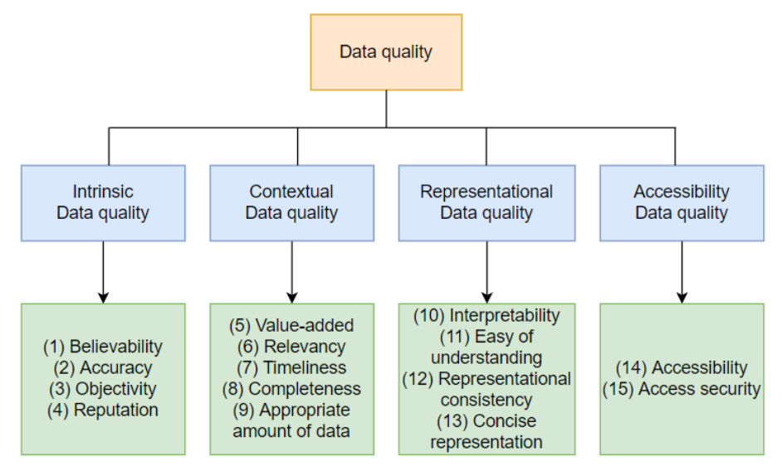
Data Quality Evaluation Framework
Wang, R. Y., & Strong, D. M. (1996). Beyond accuracy: What data quality means to data consumers. Journal of management information systems, 12(4), 5-33.
1/11/26

Slide 13
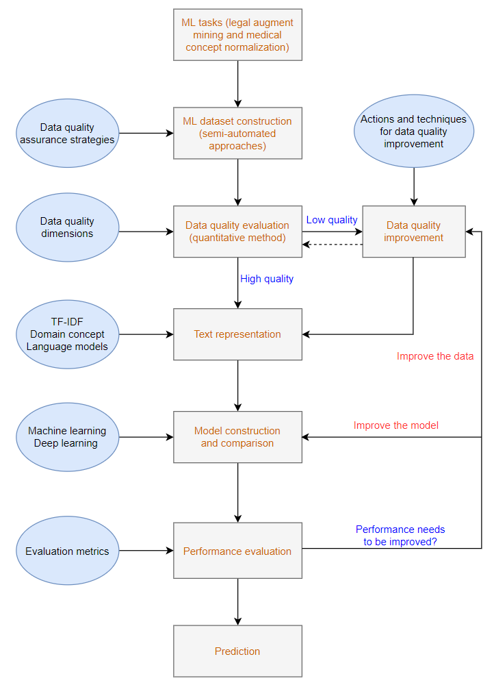
Data Quality Evaluation for Machine Learning
1/11/26

Slide 14
3
Data Preprocessing Tasks
1/11/26

Slide 15
Data Preprocessing Tasks
Data description
Data cleaning
Data integration
Data reduction

Slide 16
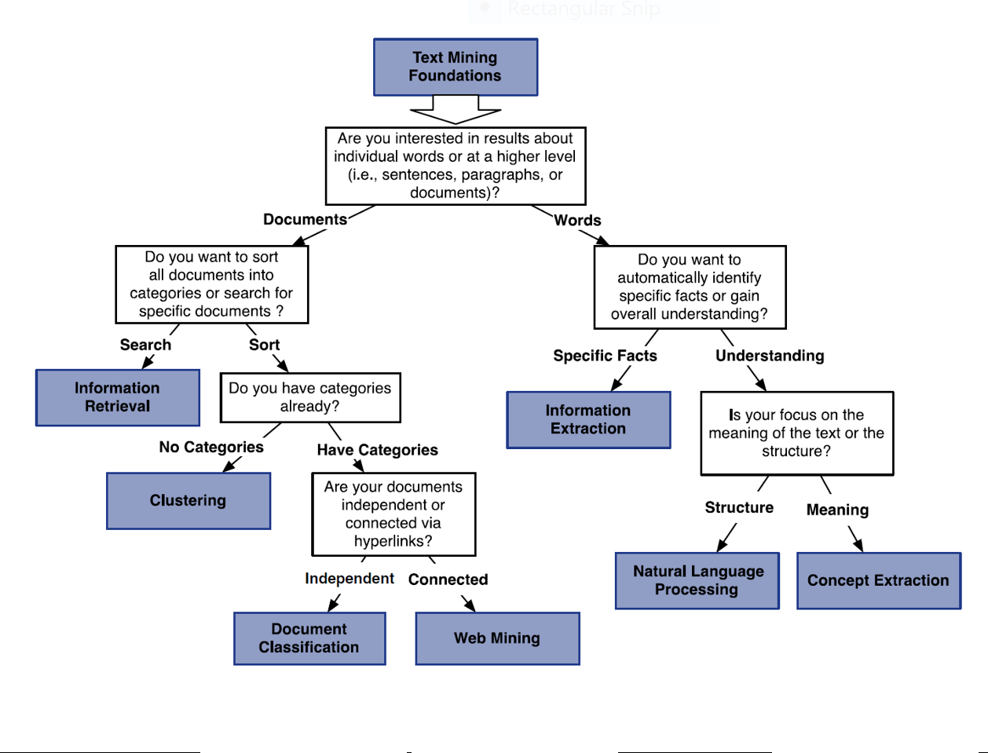
Data Preprocessing Tasks - Data Description

Slide 17
Data Preprocessing Tasks - Data Description
Motivation
To better understand the data: central tendency, variation and spread
Text dispersion characteristics
Variance, length, language, domain
Median, max, min, outliers
Numerical dimensions correspond to sorted intervals
Data dispersion: analyzed with multiple granularities of precision

Slide 18
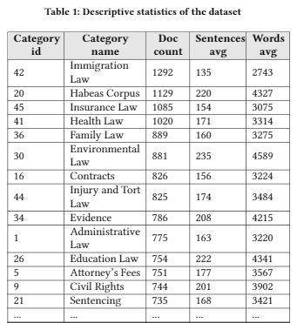
Data Preprocessing Tasks - Data Description
Chen, H., Wu, L., Chen, J., Lu, W., & Ding, J. (2022). A comparative study of automated legal text classification using random forests and deep learning. Information Processing & Management, 59(2), 102798.

Slide 19
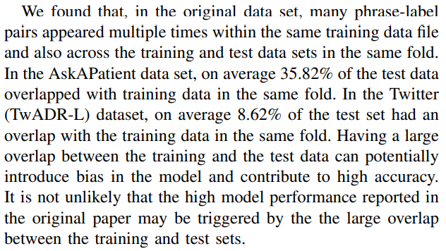
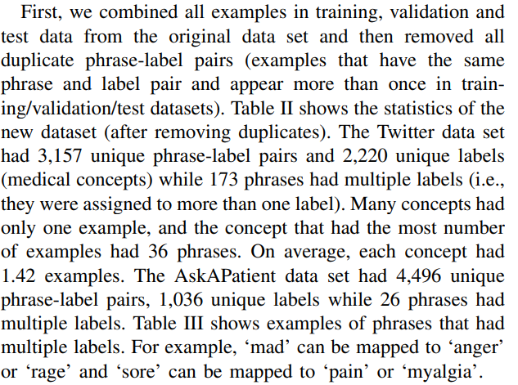
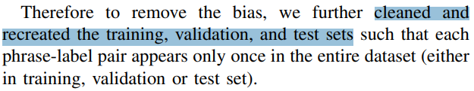
Data Preprocessing Tasks - Data Description
Lee, Kathy, Sadid A. Hasan, Oladimeji Farri, Alok Choudhary, and Ankit Agrawal. "Medical concept normalization for online user-generated texts." In 2017 IEEE International Conference on Healthcare Informatics (ICHI), pp. 462-469. IEEE, 2017.

Slide 20
Data Preprocessing Tasks - Data Cleaning
Fill in missing values
Identify outliers and smooth out noisy data
Correct inconsistent data
Resolve redundancy caused by data integration

Slide 21
Data Preprocessing Tasks - Data Cleaning
Missing Data:
Data is not always available
E.g., many tuples have no recorded value for several attributes, such as customer income in sales data
Missing data may be due to
Not accessible
Inconsistent with other recorded data and thus deleted
Data not entered due to misunderstanding
Certain data may not be considered important at the time of entry
How to Handle Missing Data:
Ignore the record
Fill in the missing value manually
Fill it in automatically with some value (mean, mode, …)

Slide 22
Data Preprocessing Tasks - Data Cleaning
Noisy Data:
Noise: random error or variance in a measured variable
Incorrect attribute values may be due to
faulty data collection instruments
data entry problems
data transmission problems
technology limitation
inconsistency in naming convention
Other data problems which requires data cleaning
duplicate records
incomplete data
Inconsistent data

Slide 23
Data Preprocessing Tasks - Data Integration
Data integration
Combines data from multiple sources
Schema integration: e.g., A.cust-id ≡ B.cust-#
Integrate metadata from different sources
Entity identiﬁcation problem
Identify real world entities from multiple data sources, e.g., Bill Clinton = William Clinton
Detecting and resolving data value conﬂicts
For the same real-world entity, attribute values from different sources are different
Possible reasons: different representations, different scales, e.g., metric vs. British units
Handling Redundancy

Slide 24
Data Preprocessing Tasks - Data Reduction
Why data reduction?
A database/data warehouse may store terabytes of data
Complex data analysis/mining may take a very long time to run on the complete data
Data reduction
Obtain a reduced representation of the data set that is much smaller in volume but yet produce the same (or almost the same) analytical results
Data reduction strategies
Remove unimportant attributes
Text Representation
Feature selection
…

Slide 25
4
Python for Data Cleaning
1/11/26

Slide 26
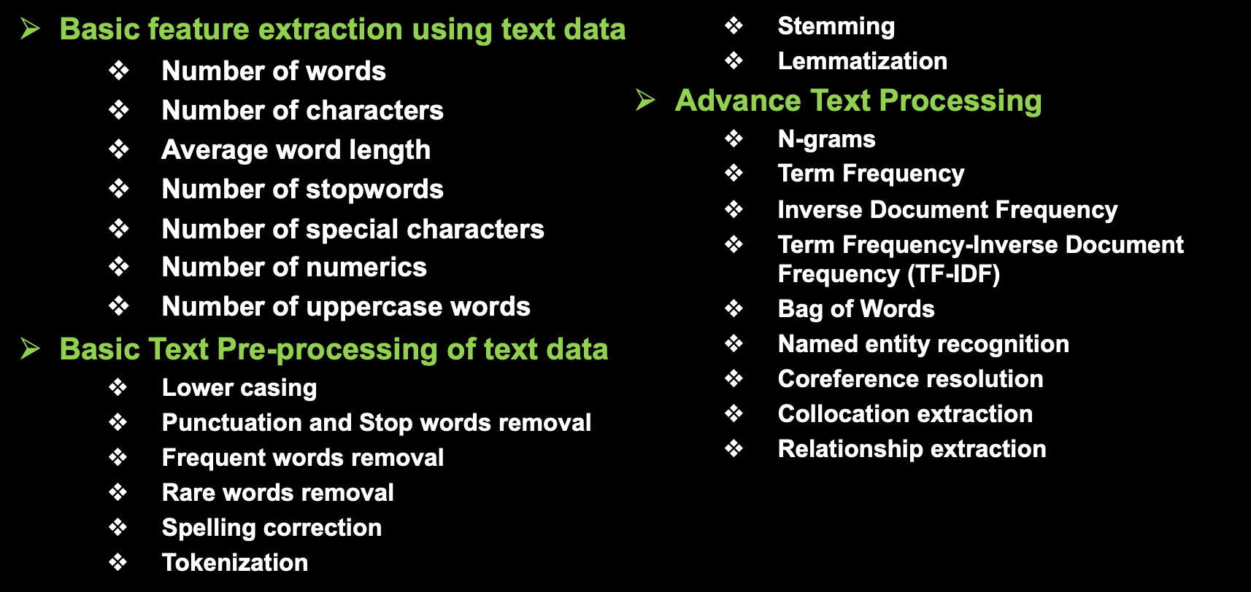
Data Preprocessing Tasks

Slide 27
Basic feature extraction using text data
Number of words
Number of characters
Average word length
Number of stopwords
Number of special characters
Number of numerics
Number of uppercase words

Slide 28
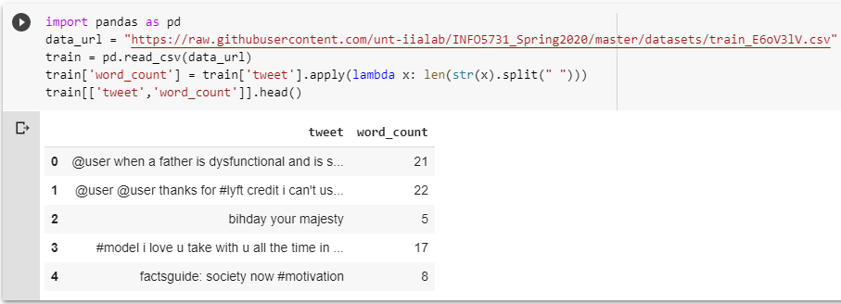
Basic feature extraction using text data - Number of words
One of the most basic features we can extract is the number of words in each tweet. The basic intuition behind this is that generally, the negative sentiments contain a lesser amount of words than the positive ones

Slide 29
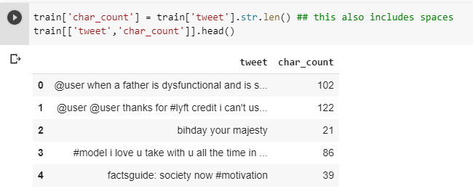
Basic feature extraction using text data - Number of characters
This feature is also based on the previous feature intuition. Here, we calculate the number of characters in each tweet. This is done by calculating the length of the tweet.

Slide 30
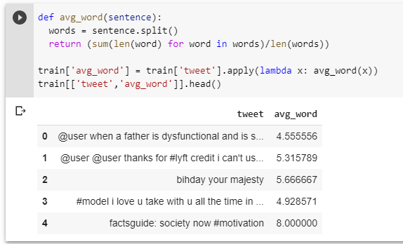
Basic feature extraction using text data - Average word length
We will also extract another feature which will calculate the average word length of each tweet.

Slide 31
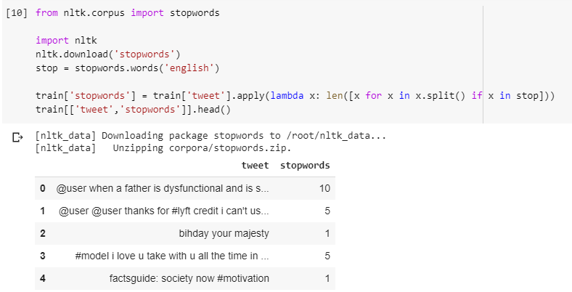
Basic feature extraction using text data - Number of stopwords
Generally, while solving an NLP problem, the first thing we do is to remove the stopwords. But sometimes calculating the number of stopwords can also give us some extra information which we might have been losing before.

Slide 32
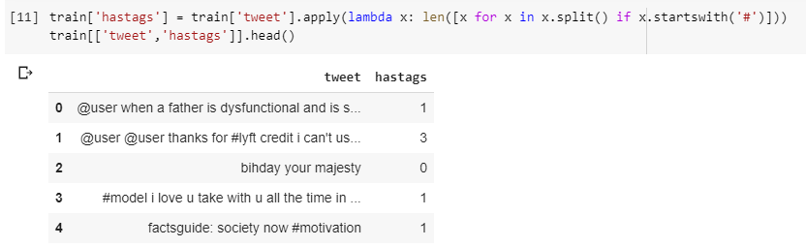
Basic feature extraction using text data - Number of special characters
One more interesting feature which we can extract from a tweet is calculating the number of hashtags or mentions present in it. This also helps in extracting extra information from our text data.

Slide 33
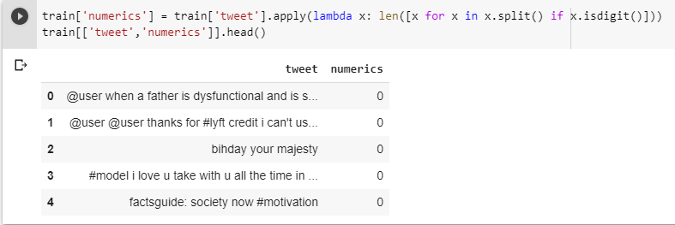
Basic feature extraction using text data - Number of numerics
Just like we calculated the number of words, we can also calculate the number of numerics which are present in the tweets.

Slide 34
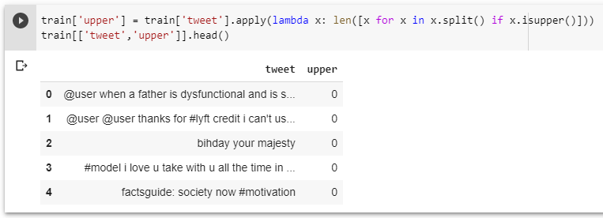
Basic feature extraction using text data - Number of Uppercase words
Anger or rage is quite often expressed by writing in UPPERCASE words which makes this a necessary operation to identify those words.

Slide 35
Basic Pre-processing of text data
Lower casing
Punctuation and Stop words removal
Frequent words removal
Rare words removal
Spelling correction
Tokenization
Stemming
Lemmatization

Slide 36
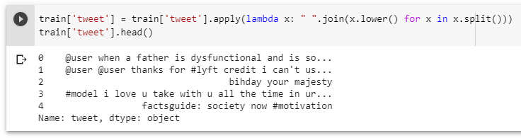
Basic Pre-processing - Lower case
The first pre-processing step which we will do is transform our tweets into lower case. This avoids having multiple copies of the same words. For example, while calculating the word count, ‘Analytics’ and ‘analytics’ will be taken as different words.

Slide 37
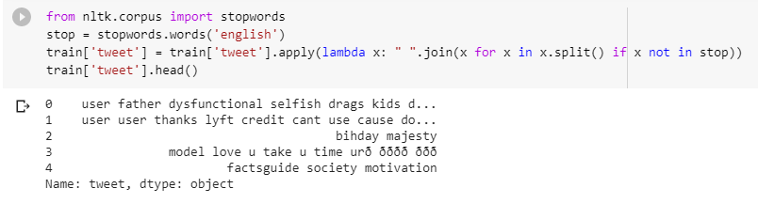
Basic Pre-processing - Removal of Punctuation and Stop Words
As we discussed earlier, stop words (or commonly occurring words) should be removed from the text data. For this purpose, we can either create a list of stopwords ourselves or we can use predefined libraries.

Slide 38
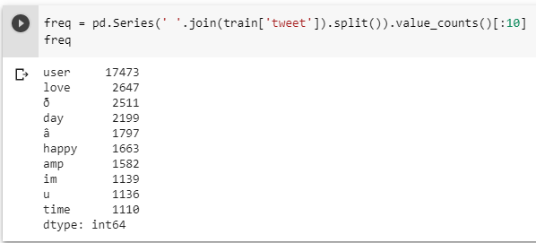
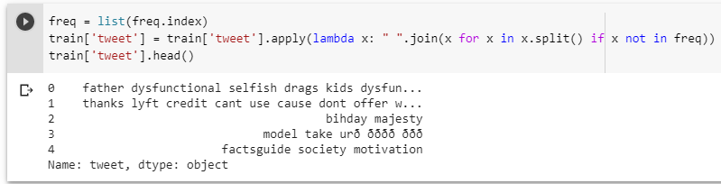
Basic Pre-processing - Common word removal
Previously, we just removed commonly occurring words in a general sense. We can also remove commonly occurring words from our text data. First, let’s check the 10 most frequently occurring words in our text data , then take a call to remove or retain them.

Slide 39
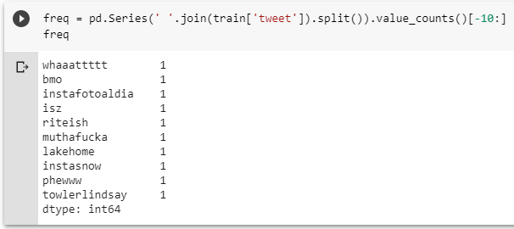
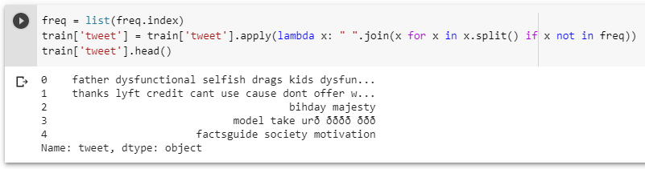
Basic Pre-processing - Rare words removal
Similarly, just as we removed the most common words, this time let’s remove rarely occurring words from the text. Because they’re so rare, the association between them and other words is dominated by noise. You can replace rare words with a more general form and then this will have higher counts

Slide 40
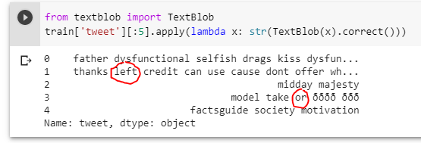
Basic Pre-processing - Spelling correction
We’ve all seen tweets with a plethora of spelling mistakes, spelling correction is a useful pre-processing step because this also will help us in reducing multiple copies of words.

Slide 41
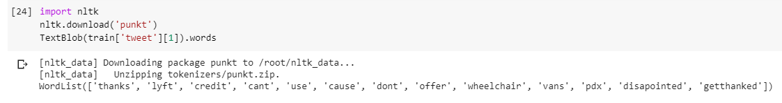
Basic Pre-processing - Tokenization
Tokenization refers to breaking a sentence or text into individual words or subwords, called tokens.
Notes:
Even sentence.

Slide 42
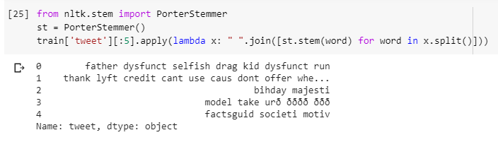
Basic Pre-processing - Stemming
Stemming refers to the removal of suffices, like “ing”, “ly”, “s”, etc. by a simple rule-based approach. For this purpose, we will use PorterStemmer from the NLTK library.
In the following example, dysfunctional has been transformed into dysfunct, among other changes.

Slide 43
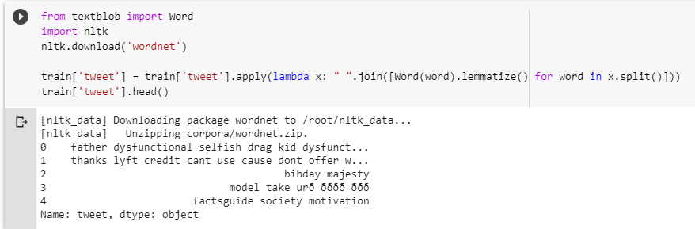
Basic Pre-processing - Lemmatization
Lemmatization is a more effective option than stemming because it converts the word into its root word, rather than just stripping the suffices. It makes use of the vocabulary and does a morphological analysis to obtain the root word. Therefore, we usually prefer using lemmatization over stemming.

Slide 44
Advance Text Processing
N-grams
Term Frequency
Inverse Document Frequency
Term Frequency-Inverse Document Frequency (TF-IDF)
Bag of Words
Named entity recognition
Coreference resolution
Collocation extraction
Relationship extraction

Slide 45
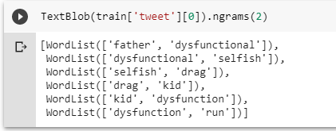
Advance Text Processing - N-grams
N-grams are the combination of multiple words used together. N-grams with N=1 are called unigrams. Similarly, bigrams (N=2), trigrams (N=3) and so on can also be used.

Slide 46
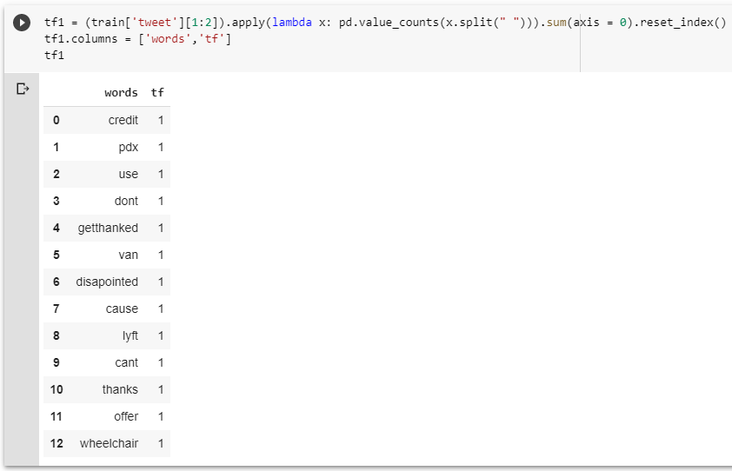
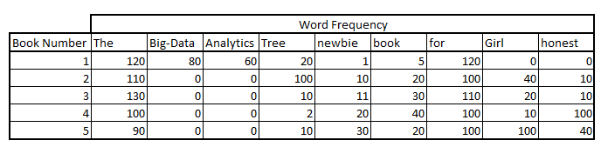
Advance Text Processing - Term frequency
The term frequency of a word in a document. There are several ways of calculating this frequency, with the simplest being a raw count of instances a word appears in a document. Then, there are ways to adjust the frequency, by length of a document, or by the raw frequency of the most frequent word in a document.:
TF = Term Frequency (TF) is to just count the number of occurrence.
Notes:
https://www.analyticsvidhya.com/blog/2015/04/information-retrieval-system-explained/
https://www.analyticsvidhya.com/blog/2017/06/word-embeddings-count-word2veec/
https://monkeylearn.com/blog/what-is-tf-idf/#:~:text=TF%2DIDF%20is%20a%20statistical,across%20a%20set%20of%20documents.

Slide 47
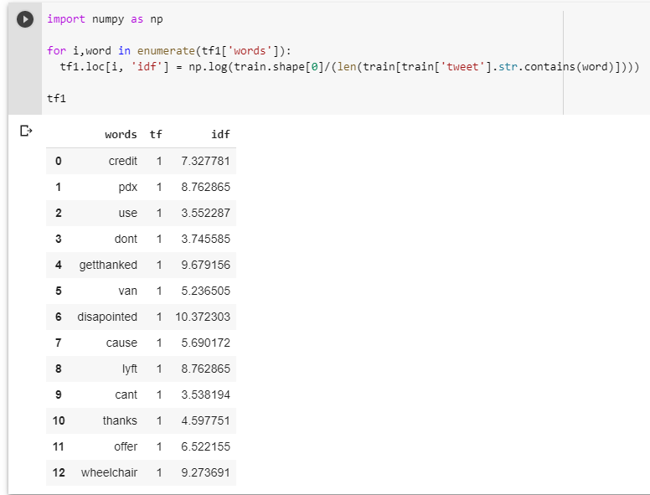
Advance Text Processing - Inverse Document Frequency
The inverse document frequency of the word across a set of documents.
How common or rare a word is in the entire document set.
The closer it is to 0, the more common a word is.
IDF = log(N/n)
where N is the total number of documents and n is the number of documents in which the word was present.
Notes:
IDF = the total number of documents, divided by the number of documents that contain a word, and calculating the logarithm.

Slide 48
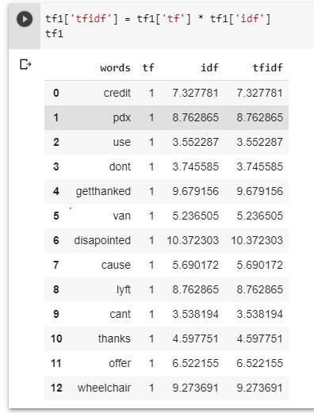
Advance Text Processing - Term Frequency – Inverse Document Frequency (TF-IDF)
TF-IDF = TF * IDF
We can see that the TF-IDF has penalized words like ‘don’t’, ‘can’t’, and ‘use’ because they are commonly occurring words.
However, it has given a high weight to “disappointed” since that will be very useful in determining the sentiment of the tweet.

Slide 49
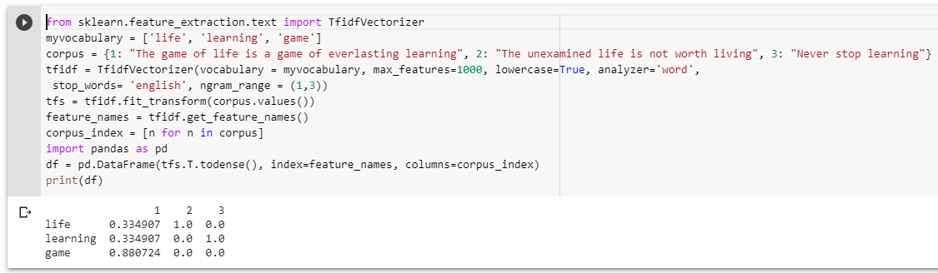
Advance Text Processing - Term Frequency – Inverse Document Frequency (TF-IDF)
Calculating TF-IDF with sklearn
Notes:
We don’t have to calculate TF and IDF every time beforehand and then multiply it to obtain TF-IDF. Instead, sklearn has a separate function to directly obtain it

Slide 50
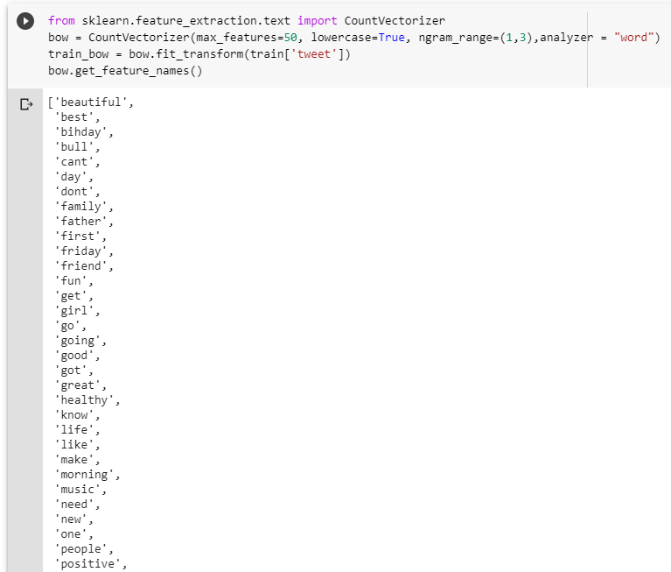
Advance Text Processing - Bag of Words
Bag of Words (BoW) refers to the representation of text which describes the presence of words within the text data.
Two similar texts containing similar kinds of words,
=> will have similar bags of words
Notes:
The intuition behind this is that two similar text fields will contain similar kinds of words and will therefore have a similar bag of words. Further, that from the text alone, we can learn something about the meaning of the document.

Slide 51
5
Regular Expression
1/11/26

Slide 52
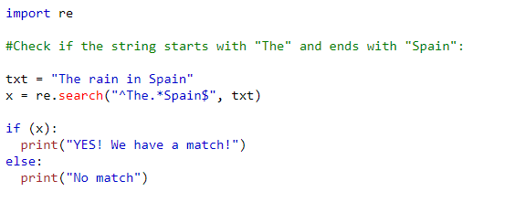
Regular Expression in NLP
A RegEx, or Regular Expression, is a sequence of characters that forms a search pattern.
RegEx can be used to check if a string contains the specified search pattern (for example, email, phone number, date, hashtag, url, etc).
Python has a built-in package called re, which can be used to work with Regular Expressions.
import re

Slide 53
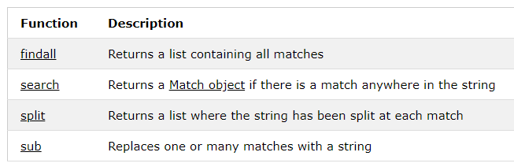
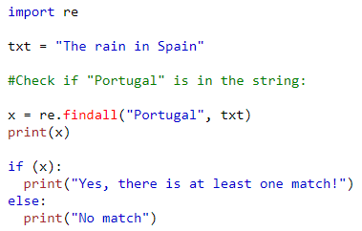
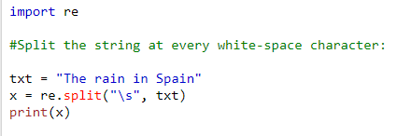
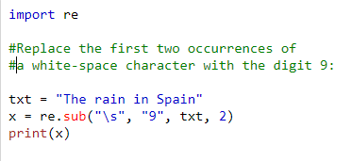
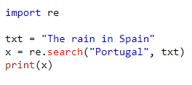
RegEx Functions
Usage: re.findall(), re.search(), re.split, re.sub()

Slide 54
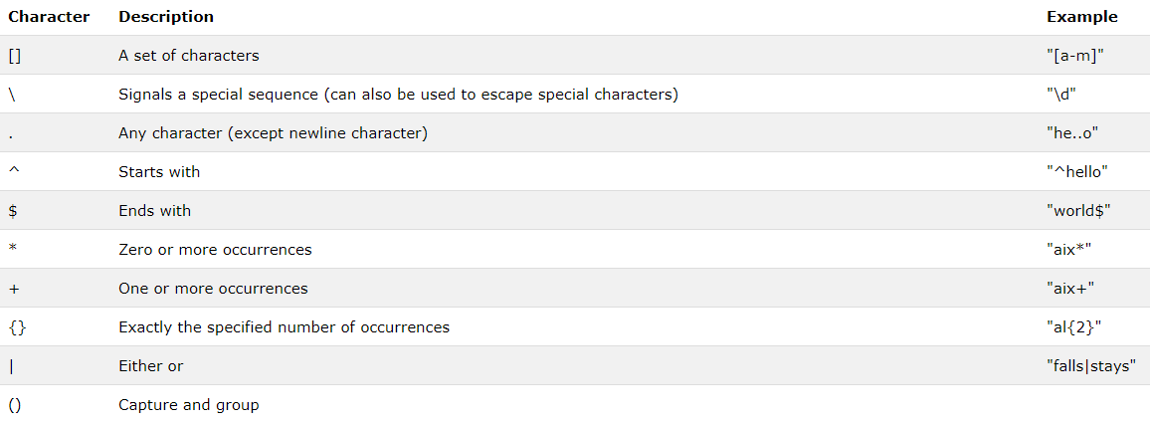
Metacharacters

Slide 55
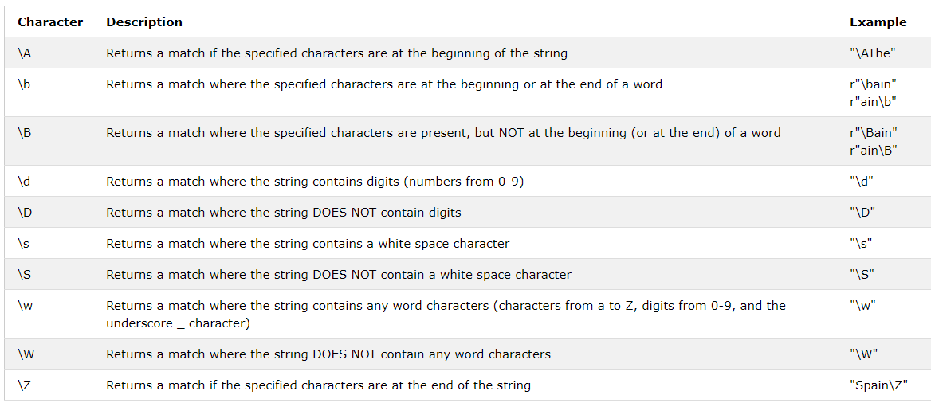
Special Sequences

Slide 56
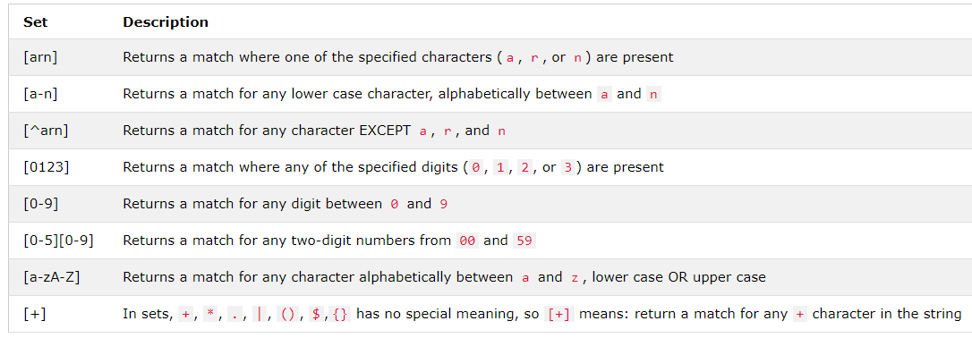
Sets

Slide 57
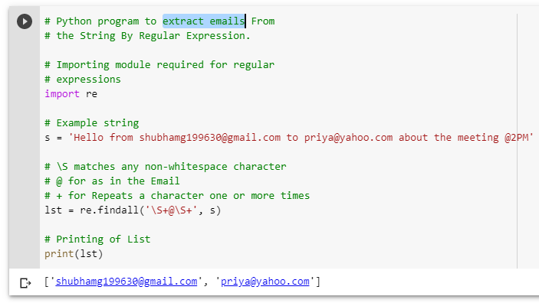
Examples - extract emails by RegEx

Slide 58
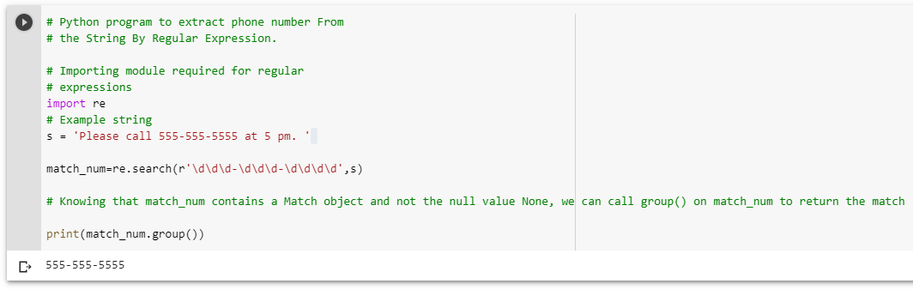
Examples - extract phone number by RegEx

Slide 59
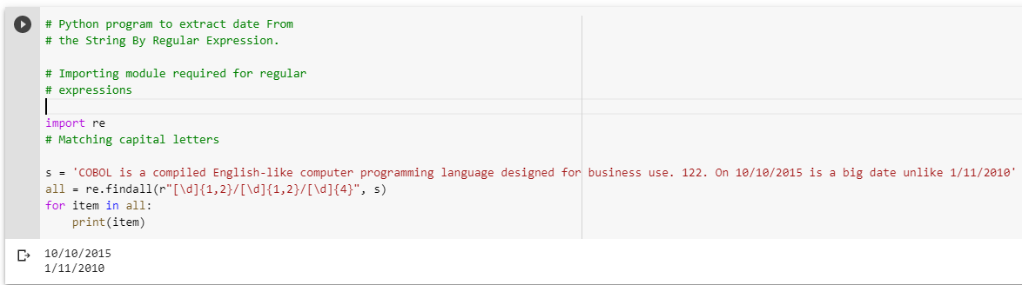
Examples - extract date by RegEx

Slide 60
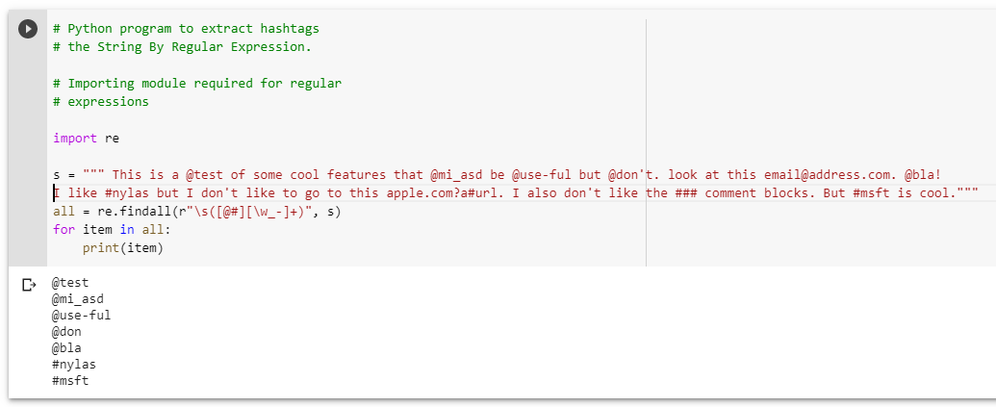
Examples - extract hashtags by RegEx

Slide 61
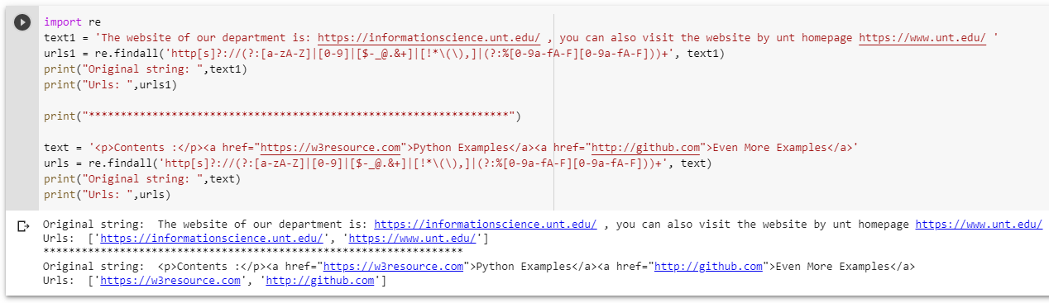
Examples - extract urls by RegEx

Slide 62





Tools for testing your Regular Expression
Regular Expression 101: https://regex101.com/

Slide 63
Thank you
1/11/26

